Slide 1
AR Pets
Second Update

Slide 2
What We’ve Done
Unity Work/Tutorials
Model Work
Interface Design
Roadmap To Break
Funding/Tech Shift

Slide 3
Unity Work
Free Asset Cat
Animations included
Baseline for…
Model
Animations

Slide 4
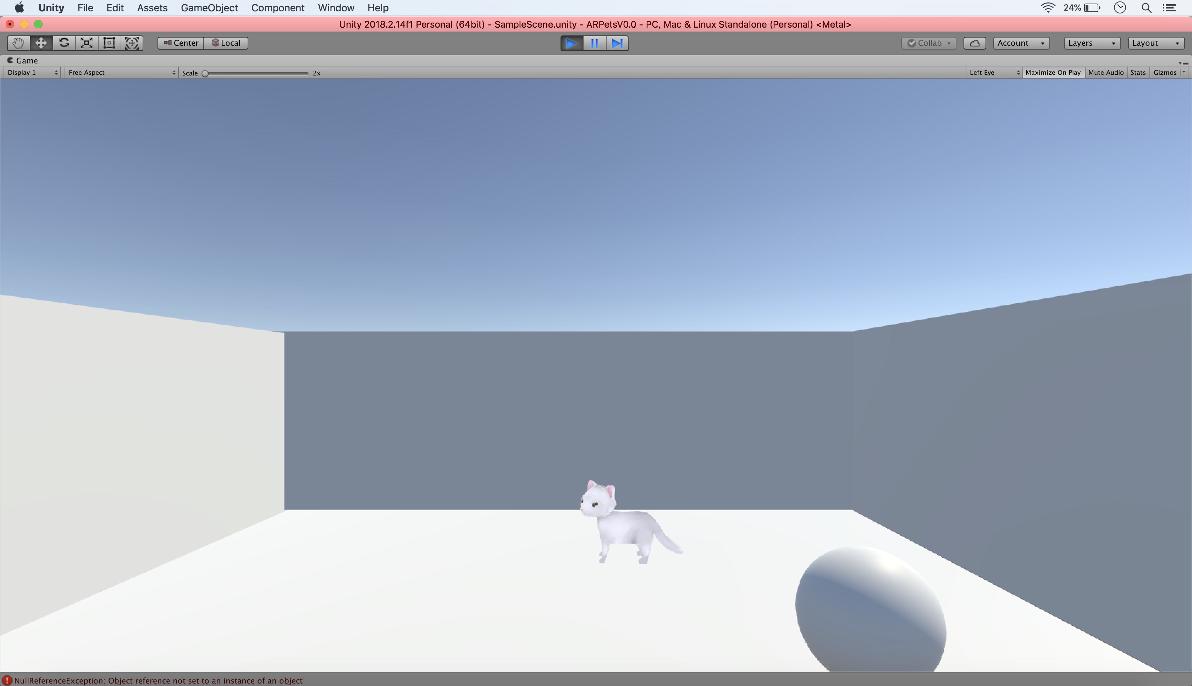

Slide 5
Unity Tutorials
Roll-a-ball (Yes, the infamous one.)

Slide 6
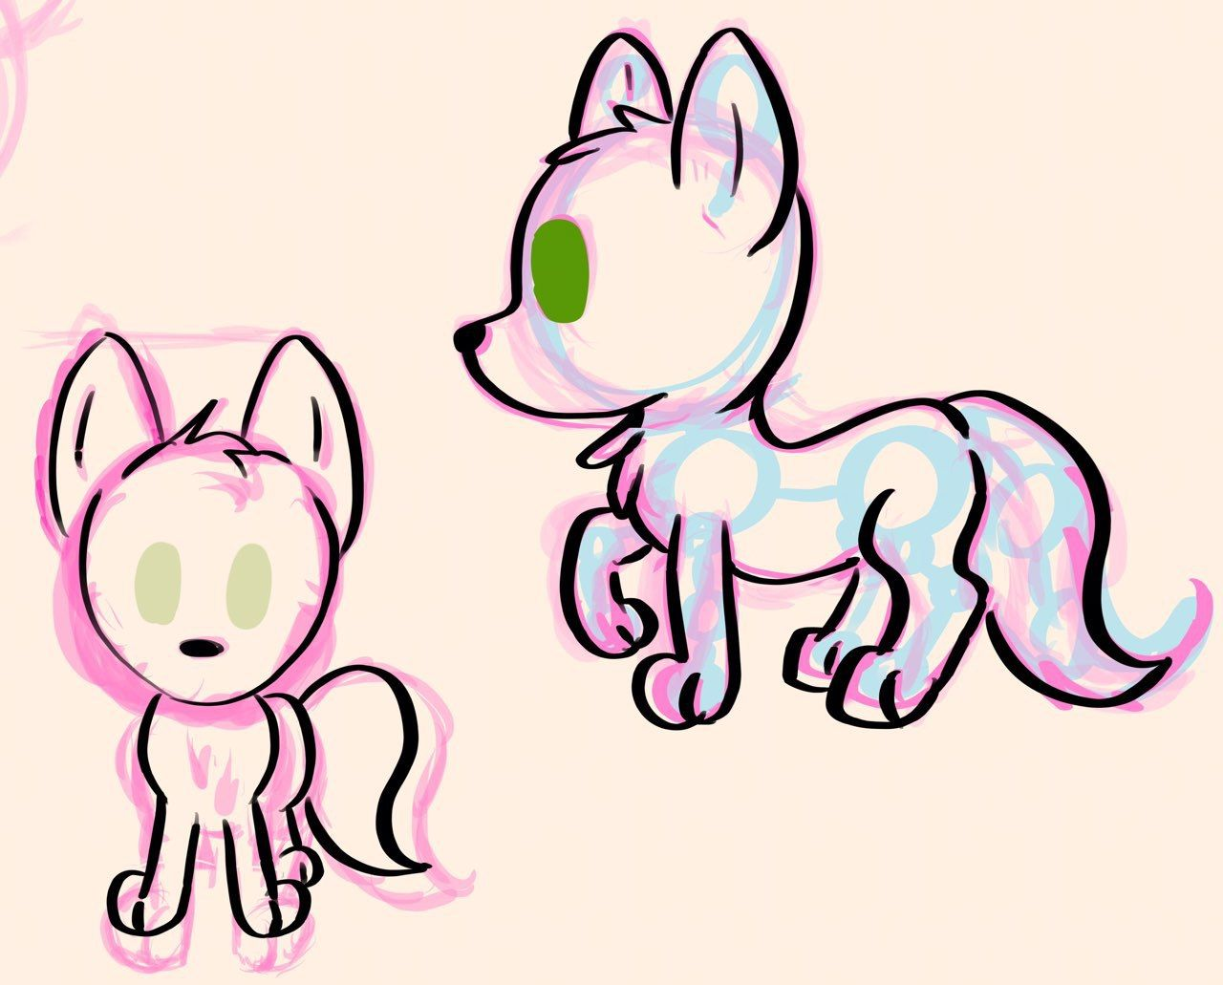
Model Work
Sketch, Modeling/Rigging in Blender

Slide 7
Interface Design
(see next slide)

Slide 8
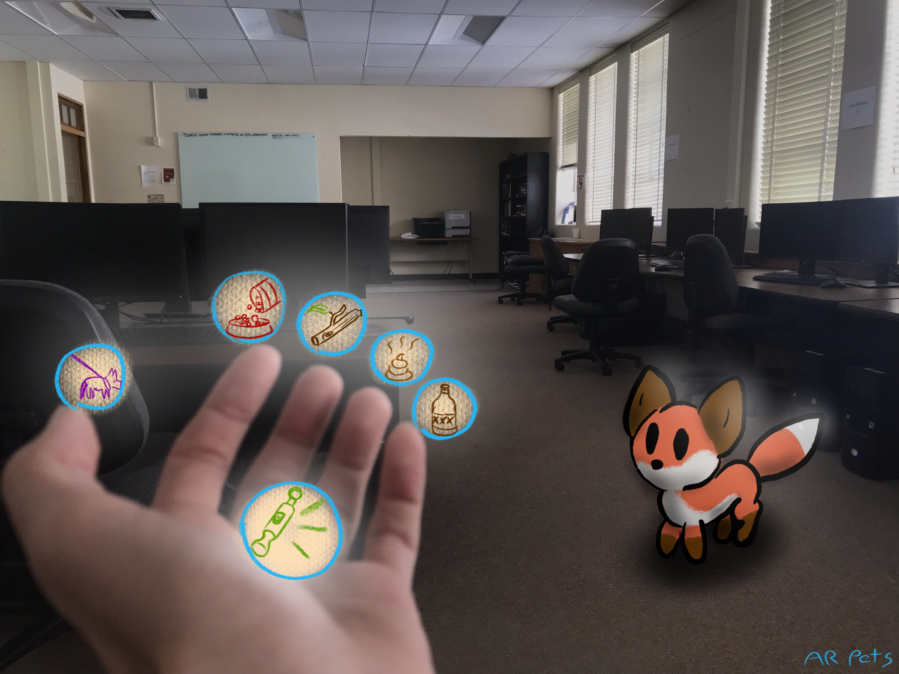

Slide 9
Roadmap to Break
Headset Interactivity
Furnished Environment
Models and Animations Done
Images:
http://fortune.com/2016/01/09/heres-what-its-like-to-use-the-oculus-rift/ https://www.youtube.com/watch?v=BYWgx5lleLI

Slide 10
Funding
No funding - University Resources
Magic Leap Grant?
Images:
https://medium.com/@LUCYDLTD/all-sizzle-and-no-steak-magic-leap-finally-releases-their-first-headset-c8cf26935 https://en.wikipedia.org/wiki/Magic_Leap

Slide 11
Tech Shift
Now focusing on both AR and VR
Currently have access to the following platforms
Oculus
Vive
Hololens
Leap Motion
Mobile Devices

Slide 12

Thank you!

